Slide 1

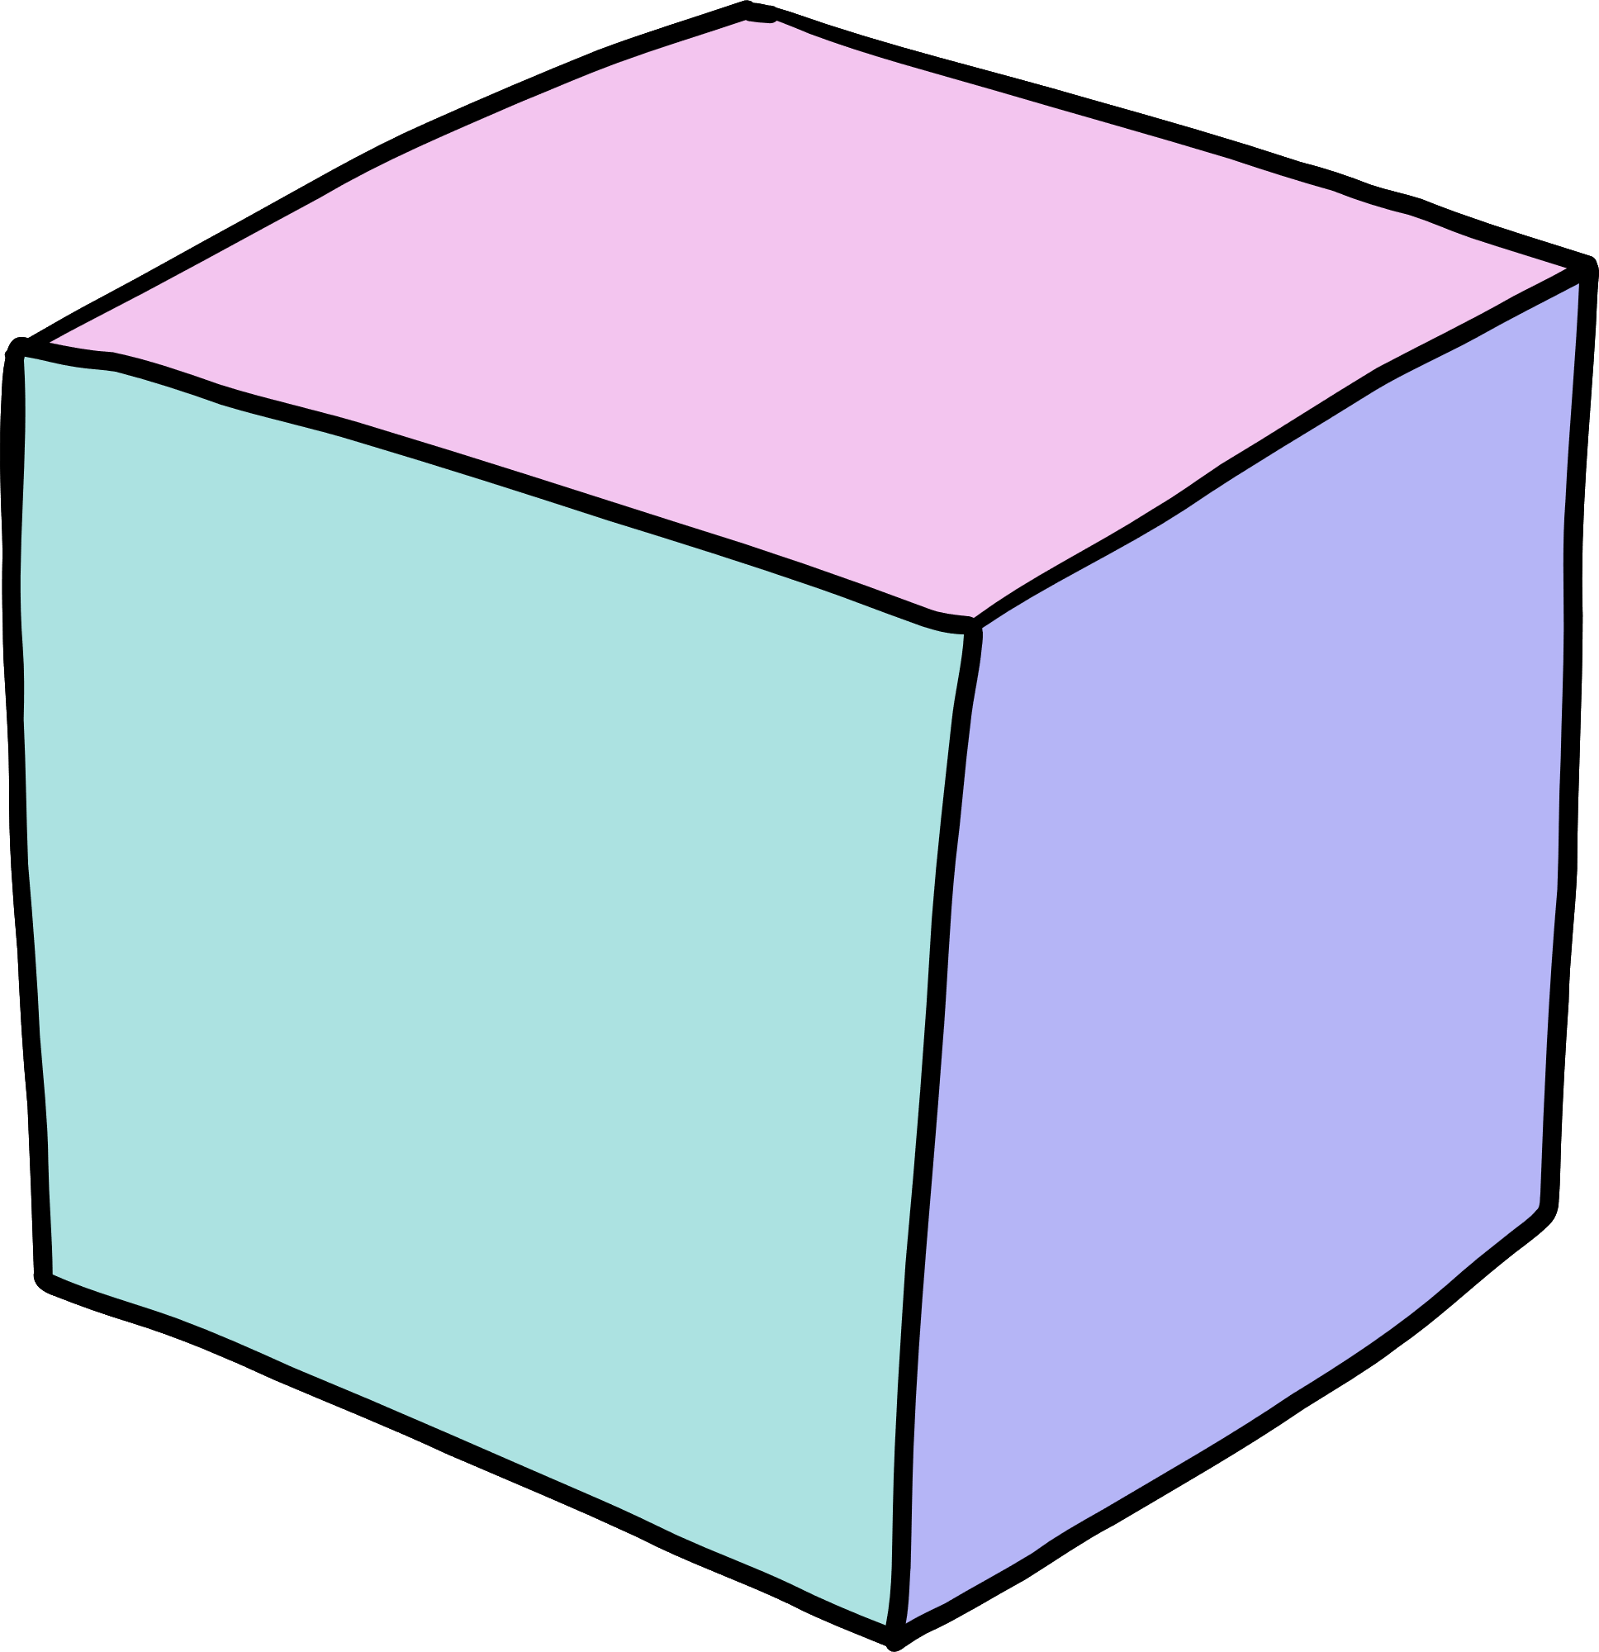
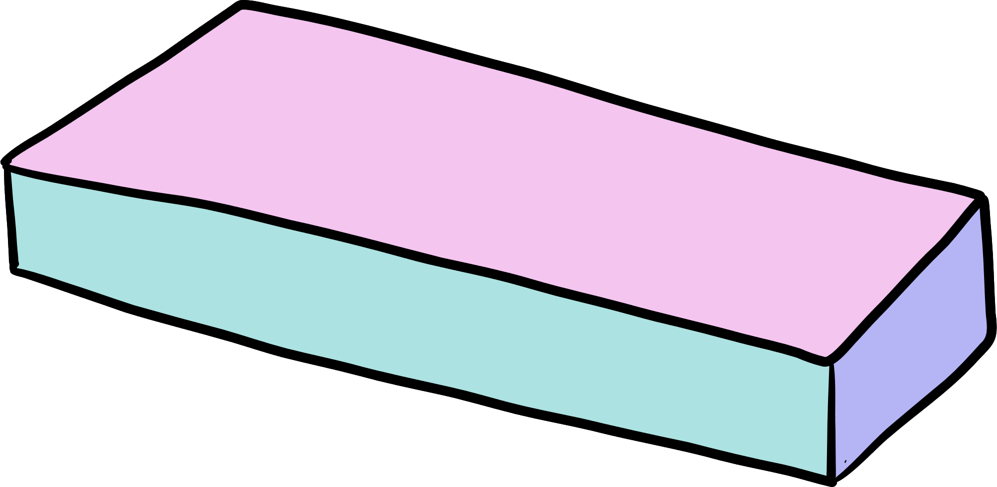

Autonomous Assistance for Alzheimer’s Patients
Paper ID : 170
Authors
Nithin Kumar
Rishwanth Praveen
Mentors
Mr Julian Menezes
Dr . Satyalakshmi

Slide 2

AGENDA
Introduction
Scope
Literature Survey
Proposed system
Modules Description
Simulation and Analysis
Conculsion and Analysis

Slide 3

INTRODUCTION
Alzheimer's disease (Ad) is a disease that becomes more and more inhibiting of memory with a progressive course over time it also affects thinking and causes visual impairment. Visual impairment is a customary symptom of AD, and recent studies have shown that visual interventions may improve the functioning of AD patients. This paper aims to use image processing techniques to help doctor’s detect AD at an early stage using Magnetic Resonance Imaging (MRI) of the brain. The proposed technique also includes camera-based detection for visually impaired or AD individuals to recognize text, objects and known people in real-time using face recognition and sign language. Optical Character Recognition (OCR) method is used to transform pictures to text, and ML is used to detect known faces, objects, and sign language. The output will be expressed in the form of an audio stream with the help of text to speech

Slide 4

SCOPE
Improved independence: By being able to recognize the faces of friends, family, and colleagues, they would be able to more easily navigate social situations and participate in everyday activities without relying on assistance from others.
Enhanced social interaction: Face recognition technology could also improve the social interactions of visually impaired individuals by allowing them to better recognize and engage with others. This could lead to increased socialization and a sense of belonging within their communities.
Increased employment opportunities: By being able to more easily identify and interact with coworkers and customers, visually impaired individuals may be more likely to be hired for jobs that require social interaction.
Decreased stigma:. As the technology becomes more widespread and accepted, it may help to reduce the negative stereotypes and biases that some people hold about individuals with visual impairments.
Help doctors gain initial insight on the stage of MRI

Slide 5


LITERATURE SURVEY
Detecting Affect states Using VGG16, ResNet50 and Se-ResNet50
Dhananjay Theckedath and R.R.Sedemkar
SN Computer Science 2020 Article 79
Aim
To compare three pretrained networks on the Cohn kanade Dataset to compare the accuracy alongside other performance matrices like precision and recall
Algorithms Used
VGG16
ResNet50
Se-Resnet50
Achieved Results
Resnet 50 achieved the best accuracy , precision and recall and takes much lesser epochs compared to SeResNet50 . Resnet has a notably good validaton accuracy of 0.9954
Drawbacks
There are methods to further reduce the epochs that has not been implemented
Redesigning the model
We also use Xception architecture with Resnet50 to further improve accuracy

Slide 6
Towards assisting visually impaired individuals: A review on current status and future prospects
Maisha Mashiata , Tasmia Ali , Prangon Das et al.
Biosensors and Bioelectronics vol 12 , 2022
Aim
To perform an all inclusive review of the current status and future prospects of assistive devices for the visually impaired
Methods Used
Evolution of assistive devices
Taxonomy of assistive devices
Features of assistive devices
Commonly employed algorithms
Canny edge detection
YOLOv3
CNN
Tests and experiments of assistive devices
Achieved Results
The conclusion is that no device is regarded to be an optimal device. Therefore, there is a requirement for designing an intelligent system capable of covering essential characteristics for supporting visually impaired people.
Drawbacks
The study is mostly based on developed countries and doesn’t include developing countries
Redesigning the model
The ideology behind our project is to develop a cost effective , reliable and robust system for the
visually impaired . We integrate functionalities to help the affected

Slide 7
OCR with Tesseract, Amazon Textract, and Google Document AI: a benchmarking experiment.
Thomas Hegghammer , Journal of Computational Social Science 2021
Aim
This article reports a benchmarking experiment comparing the performance of various Optical Character recognition algorithms
Algorithms Used
Tesseract
Amazon textract
Google Document Ai
Achieved Results
Google Document Ai had consistently lower error rates with Amazon Textract coming close second and tesseract last .
Drawbacks
Google Document Ai are server based processor
Redesigning the model
We will be using Pytesseract which serves as a wrapper for the Google document AI

Slide 8
Follow My Eye: Using Gaze to Supervise Computer-Aided Diagnosis
IEEE Transactions on Medical Imaging , July 2022
Aim
To demonstrate that the eye movement of radiologists reading medical images can be a new form of supervision to train the DNN-based computer-aided diagnosis (CAD) system
Algorithms Used
ResNet50
ResNet18
ResNetNeXt
Achieved Results
Resnet 50 backbone proved to be a conventional system to classify medical images.
Drawbacks
Specifically trained for gazed attention maps
Redesigning the model
Resnet 50 will be used to classify MRI images for which training data will be provided

Slide 9
Computer Vision Based Classroom Attendance Management System with Speech Output using LBPH Algorithm
D Bhavana , K Kishore Kumar, N kausik et al.
Internation Journal of Speech Technology
Aim
To solve the illumination problem of the conventional face recog- nition system using Haarcascade algorithm, LBPH is merged into the system with the HOG linear SVM object detector
Algorithms Used
Haarcascade
LBPH
HOG
Achieved Results
Efficient face recognition scheme is proposed and implemented By merging LBPH algorithm into conventionalHaarcascade scheme, recognition performance to detect face region is improved for not only front-view facial images but also slanted ones.Accuracy of 96.67 was achieved
Drawbacks
Haarcascade has a difficulty with recognizing faces from a slanted standpoint. Haarcascade Is fast at generating a region of interest but often is not accurate.
Redesigning the model
We merge LBPH with Haarcascade that improves detection for frontal view face images
and also slanted ones

Slide 10
PROPOSED SYSTEM
Our objective is to develop a Dual Aid system that comprises two main components: the Doctor's Aid and the Patient's Aid. The Doctor's Aid module is designed to offer doctors a preliminary understanding and a starting point for analyzing MRI scans of patients with Alzheimer's disease. This model can be deployed on a server to provide local access within the hospital's network. Considering that visual impairment is a common symptom in Alzheimer's disease, the Patient's Aid is divided into four sub-modules that can help patients with Alzheimer's perform basic activities. These sub-modules include face detection for identifying family members, object detection for recognizing common objects in the environment, OCR for reading large print signs, and sign-to-speech, which allows patients who communicate via sign language to converse directly with their doctors.

Slide 11

Doctor’s Aid
The reason for choosing this approach is that ResNet50 and Xception have complementary strengths - ResNet50 is proficient at capturing long-range dependencies, while Xception excels at capturing local features
ResNet50 is a conventional backbone algorithm for classifying medical images
Pre-trained weights of ResNet50 from ImageNet
Xception, known to work well with ImageNet weights, was combined with ResNet50
Xception uses skip or residual connections to facilitate the flow of information from earlier layers to later layers
Patient’s Aid
The primary module of the patients aid is the face detection module where the Haar cascade classifier is used due to its quick result , low computational costs and reliability .
The Haar cascade for face detection then use the LBPH ( local binary pattern histogram ) algorithm for face recognition due to its known performance and ability to recognize the face from the frontal , rear or side view .
Optical character recognition also known as OCR will be carried out by pytesseract that will help the patients read big signs .
For object detection we are using the caffe model that can detect multiple objects in a screen
Sign to speech will be carried out with a Pretrained CNN Sequential model.
These algorithms have been selected upon extensive literature survey so that the selected algorithms work properly in all conditions where speed or accuracy is not compromised for reliance

Slide 12
MODULES
Doctor’s Aid
MRI multiclass classification
Data collection
Data preprocessing
Data training
Data tesing and validation
Visualizing the model
Deploying onto streamlit
Patient’s Aid
Face detection – Haar cascades and LBPH
Object detection – Mobilenet SSD
OCR – Pytesseract
Sign to speech – Cnn with sequential model

Slide 13
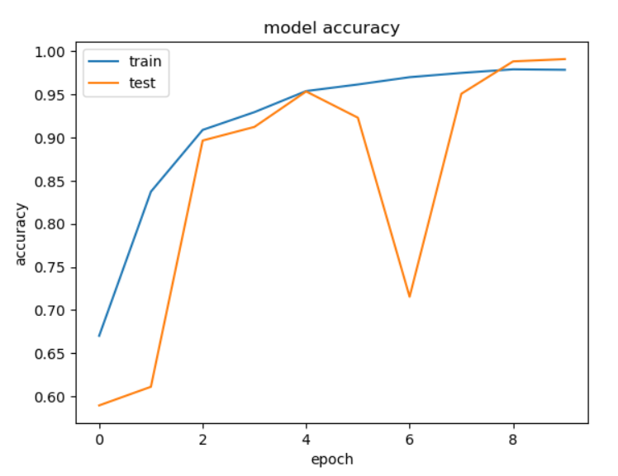
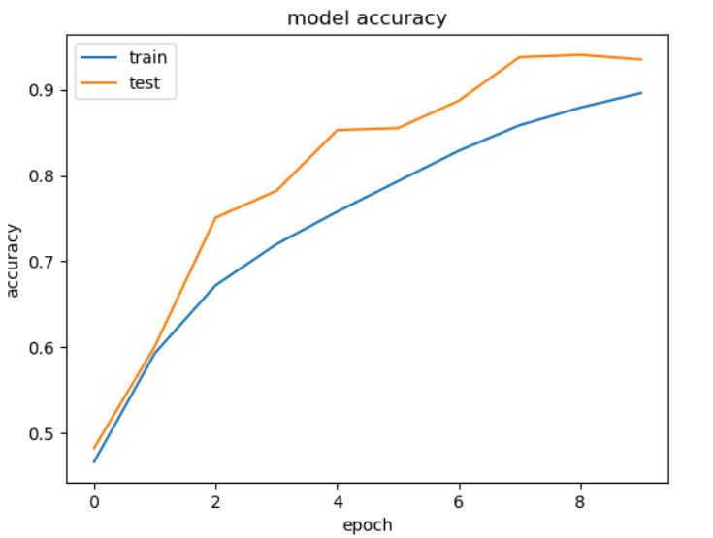
SIMULATION AND ANALYSIS
Doctor’s Aid
We used an ensemble method of Xception and Resnet50 with a shortlisted set of 3 optimizers namely Stochastic Gradient Descent (SGD) optimizer, Adaptive Moment Estimation (Adam) optimizer, and Root Mean Square Propagation (Rmsprop) optimizer
Resnet 50 with Adam and SGD optimizer respectively

Slide 14
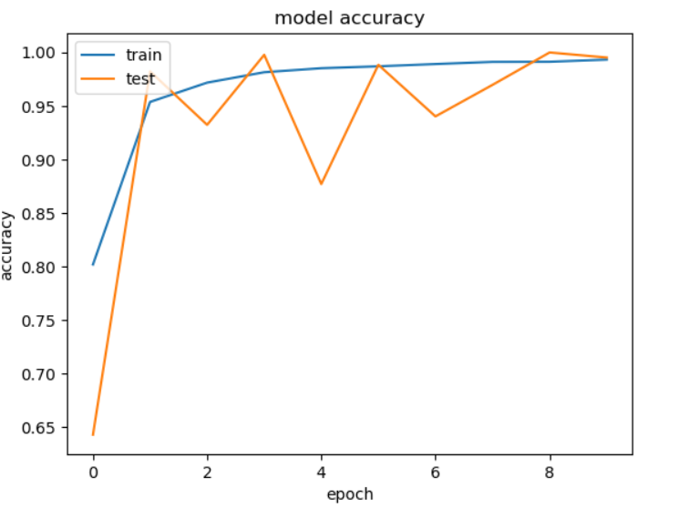
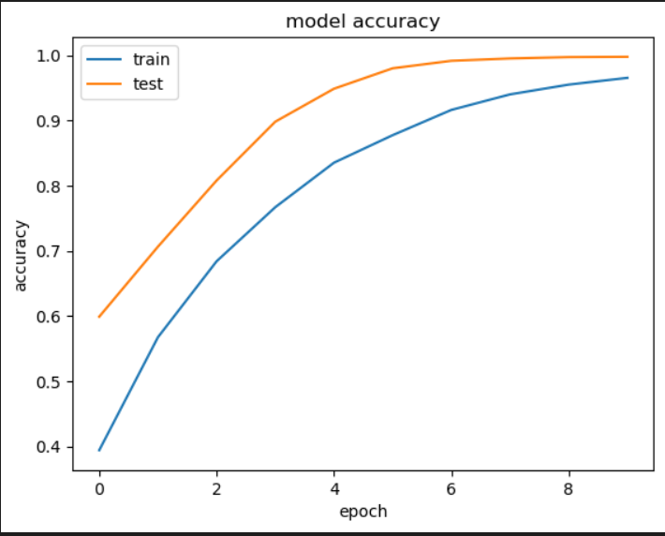
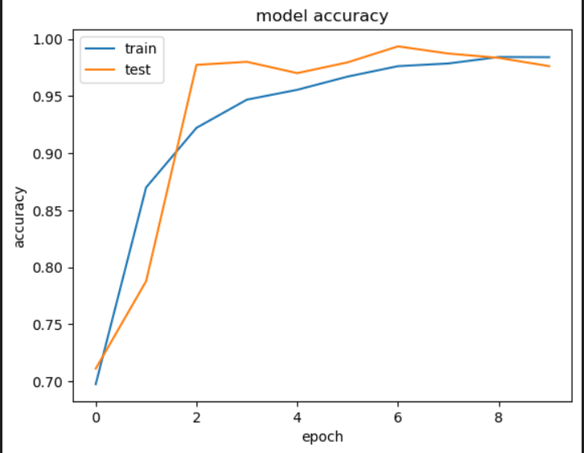
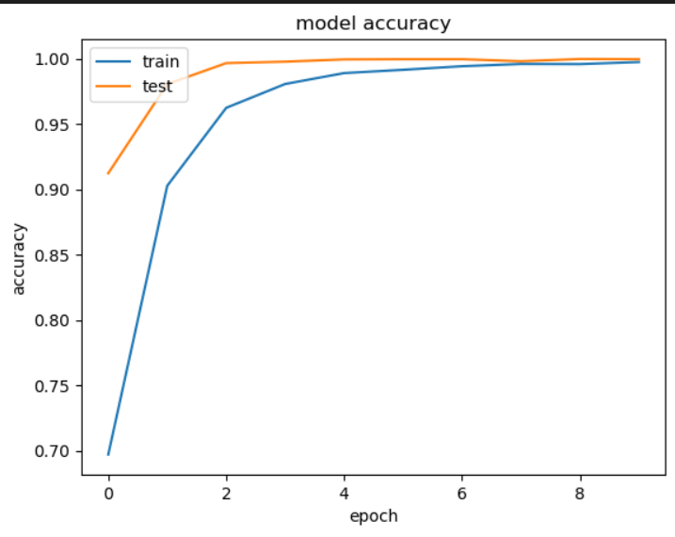
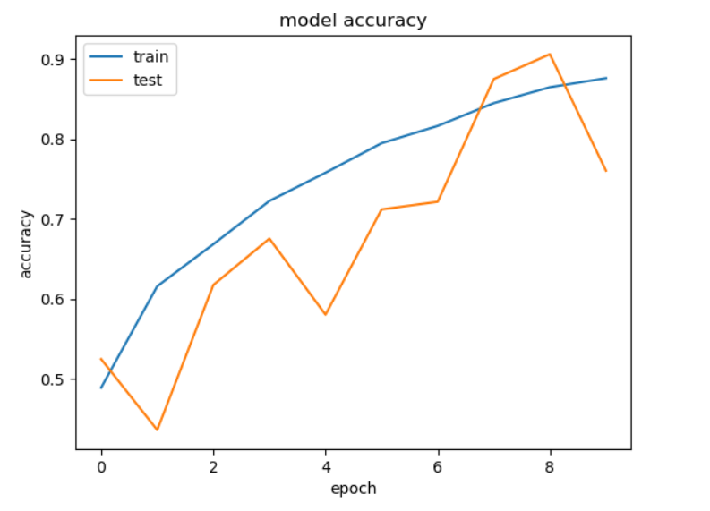
Xception with Adam and Sgd optimizer respectively
Resnet50 and Xcpetion concatenated with Adam optimizer, SGD optimizer and Rmsprop optimizer respectively

Slide 15
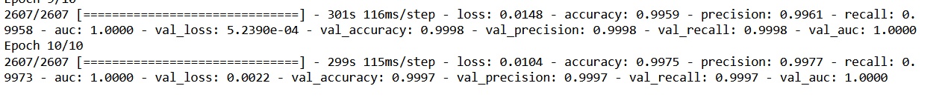
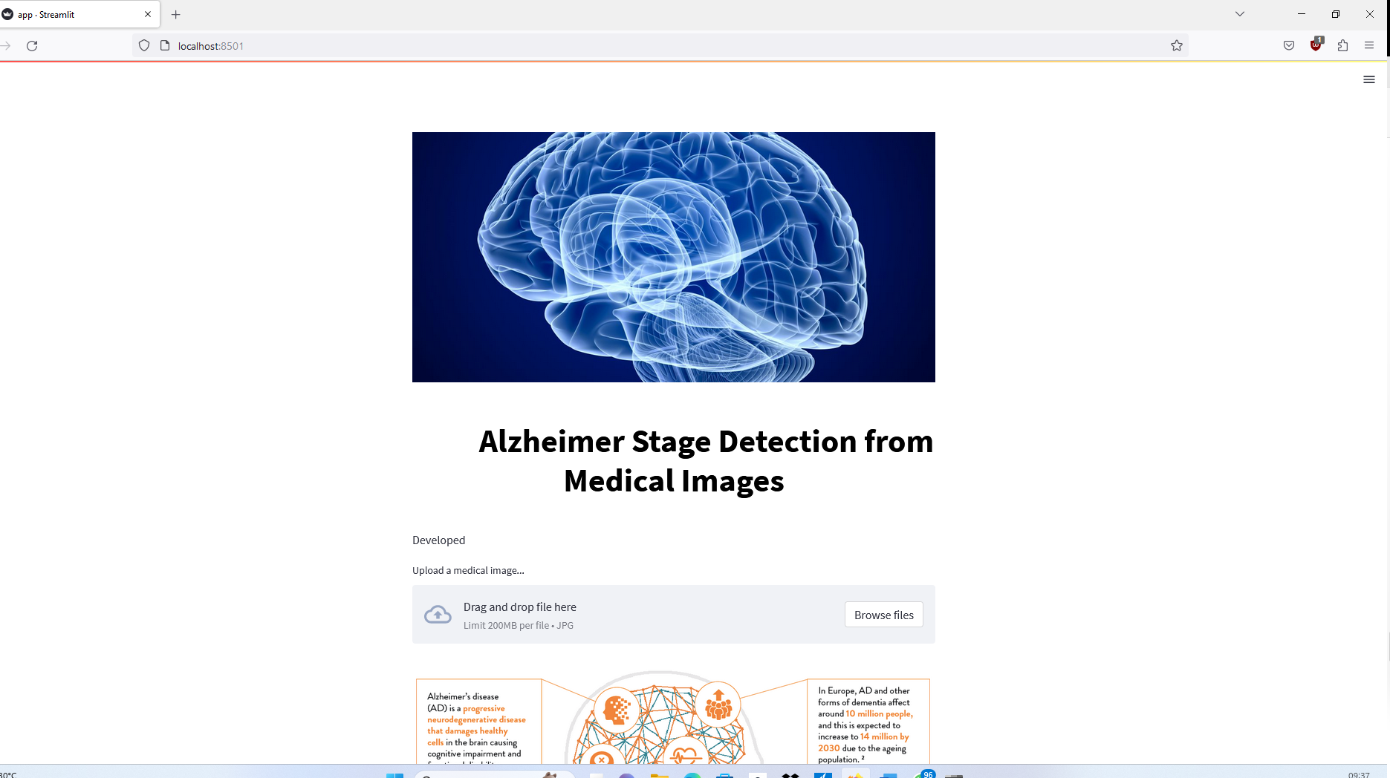

Slide 16
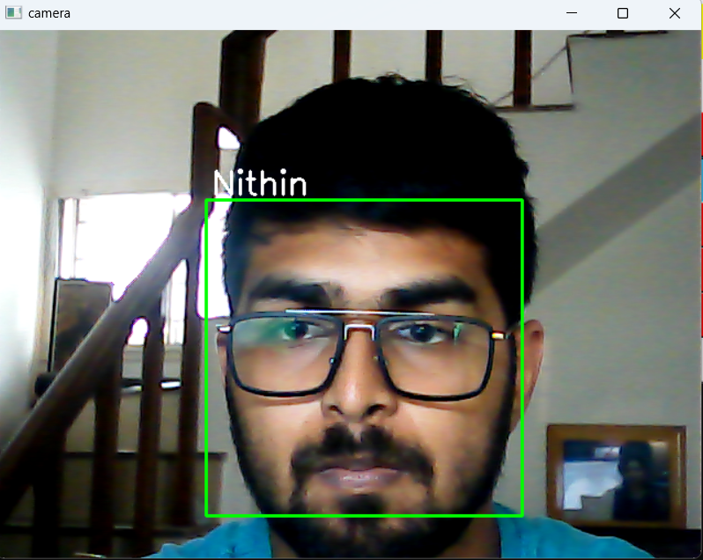
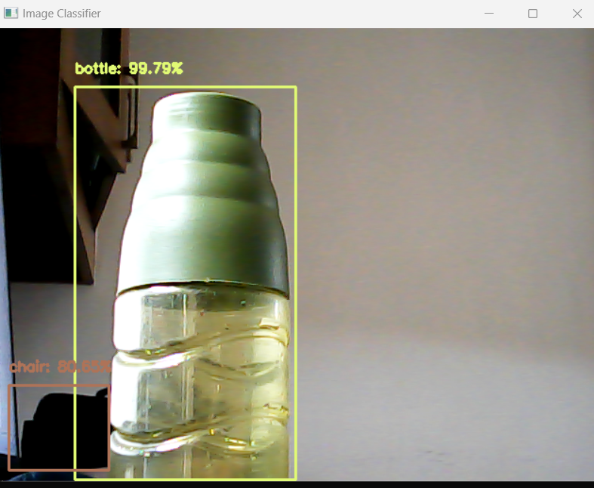
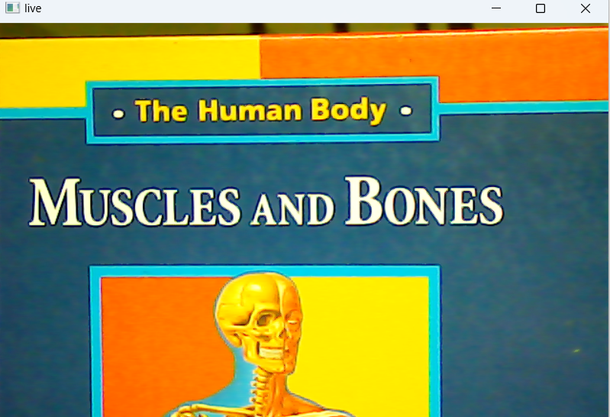
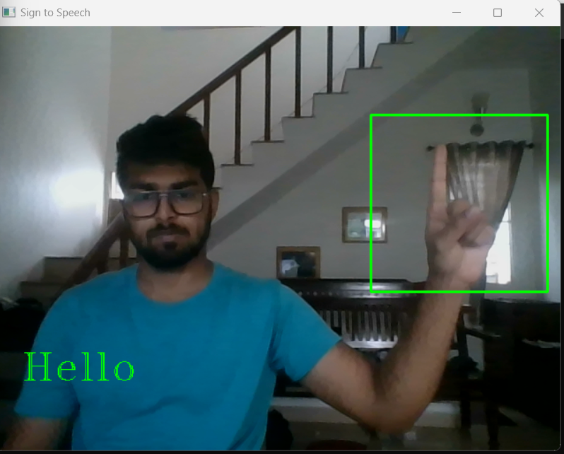
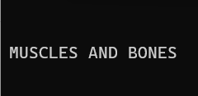
Face detection Object Detection
OCR Sign to speech

Slide 17

CONCLUSION AND FUTURE WORK
In conclusion , an effective framework has been built to for a multiclass classification where an ensemble method of concatenating the Xcpetion and Resnet 50 algorithm paired with the Sgd optimizer for classifying Mri axial cut images into for classes namely Mild demented , Very Mild Demented , Moderate Demented and Non demented provides benefits over the respective independent methods . The Patient’s Aid proved to be usable in real time
However, we need to extend the functionality of this framework to include the coronal and sagittal brain slices and add other data modalities such as, FDG-Positron Emission Tomography(PET), FDG-Positron Emission Tomography(PET), , Structural Magnetic resonance Imaging (SMRI), Computer Tomography(CT) and Functional Magnetic Resonance(Fmri).As only the Axial cut is not sufficient to provide the doctor noticable insight. The sign to speech and object detection modules need further work as they are not consistent and is built for a custom library that is restricted to a small group of objects and signs

Slide 18
REFRENCES
[1] Jennifer R. Evans, Astrid E. Fletcher, Richard P.L. Wormald,Depression and Anxiety in Visually Impaired Older People,Ophthalmology,Volume 114, Issue 2,2007,Pages 283-288,ISSN 0161-6420,
[2] Maisha Mashiata et al. Towards assisting visually impaired individuals: A review on current status and future prospects, Biosensors and Bioelectronics: X, Volume 12, 2022, 100265, ISSN 2590-1370,
[3] Theckedath, D., Sedamkar, R.R. Detecting Affect States Using VGG16, ResNet50 and SE-ResNet50 Networks. SN COMPUT. SCI. 1, 79 (2020).
[4] Besnassi, M., Neggaz, N. & Benyettou, A. Face detection based on evolutionary Haar filter. Pattern Anal Applic 23, 309–330 (2020).
[5] J. Hyun, J. Kim, C. -H. Choi and B. Moon, “Hardware Architecture of a Haar Classifier Based Face Detection System Using a Skip Scheme,” 2021 IEEE International Symposium on Circuits and Systems (ISCAS), Daegu, Korea, 2021, pp. 1-4,
[6] Hwang, J.J., Kim, Y.M., Rhee, K.H. (2019). Faces Recognition Using HAARCASCADE, LBPH, HOG and Linear SVM Object Detector. In: Hwang, S., Tan, S., Bien, F. (eds) Proceedings of the Sixth International Conference on Green and Human Information Technology. ICGHIT 2018. Lecture Notes in Electrical Engineering, vol 502. Springer, Singapore.
[7] Ahmed, H.A., Mustafa, S.Y., Braim, S.Z. et al. An Intelligent Kurdish Sign Language Recognition System Based on Tuned CNN. SN COMPUT. SCI. 3, 481 (2022).
[8] Tafti, A.P., Baghaie, A., Assefi, M., Arabnia, H.R., Yu, Z., Peissig, P. (2016). OCR as a Service: An Experimental Evaluation of Google Docs OCR, Tesseract, ABBYY FineReader, and Transym. In: , et al. Advances in Visual Computing. ISVC 2016. Lecture Notes in Computer Science(), vol 10072. Springer, Cham.
[9] Hegghammer, T. OCR with Tesseract, Amazon Textract, and Google Document AI: a benchmarking experiment. J Comput Soc Sc 5, 861–882 (2022).
[10] Ikeda, M., Oda, T. & Barolli, L. A vegetable category recognition system: a comparison study for caffe and Chainer DNN frameworks. Soft Comput 23, 3129–3136 (2019).
[11] Kaur, N., Singh, P. Conventional and contemporary approaches used in text to speech synthesis: a review. Artif Intell Rev (2022).
[12] J. Martínek, L. Lenc, P. Král, A. Nicolaou and V. Christlein, “Hybrid Training Data for Historical Text OCR,” 2019 International Conference on Document Analysis and Recognition (ICDAR), Sydney, NSW, Australia, 2019, pp. 565-570,
[13] J. Hyun, J. Kim, C. -H. Choi and B. Moon, “Hardware Architecture of a Haar Classifier Based Face Detection System Using a Skip Scheme,” 2021 IEEE International Symposium on Circuits and Systems (ISCAS), Daegu, Korea, 2021, pp. 1-4,
[14] Chunming Wu, Ying Zhang MTCNN and FACENET Based Access Control System for Face Detection and Recognition. Aut. Control Comp. Sci. 55, 102–112 (2021).
[15] Gabriel B. Holandaet al., Development of OCR system on android platforms to aid reading with a refreshable braille display in real time, Measurement,Volume 120,2018,Pages 150-168,ISSN 0263-2241,
[16] S. Wang, X. Ouyang,et.al, "Follow My Eye: Using Gaze to Supervise Computer-Aided Diagnosis," in IEEE Transactions on Medical Imaging, vol. 41, no. 7, pp. 1688-1698, July 2022,

